Slide 1
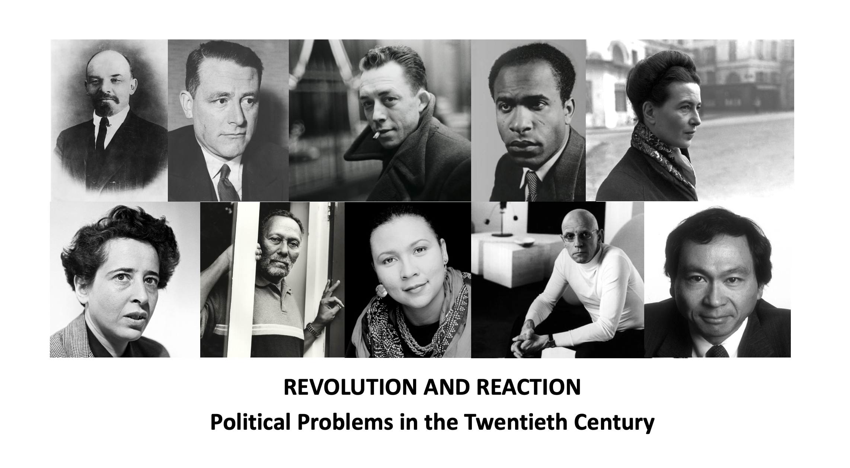
Welcome and Introduction to the Module
Jonathan Dean

Slide 2
PIED2601: The Basics
What is this module about?
So why “revolution” and “reaction”?
An exploration of the relationship between some of the key ideas that have shaped and responded to the events of the 20th century.
Revolution = profound socio-political change and upheaval
Reaction = reaction as “response” to revolution and as reactionary politics
Why is this important or worthwhile?
We are arguably still living in the shadow of the Twentieth Century
C20 political history makes no sense without an understanding of the role of ideas
Why have we chosen the thinkers we have chosen?
They reflect a diversity of voices
They engage with the key ideologies of the 20th century
Their work responds to key events of the 20th century
Their work engages with fundamental political questions

Slide 3
Our Ten Key Thinkers

Slide 4
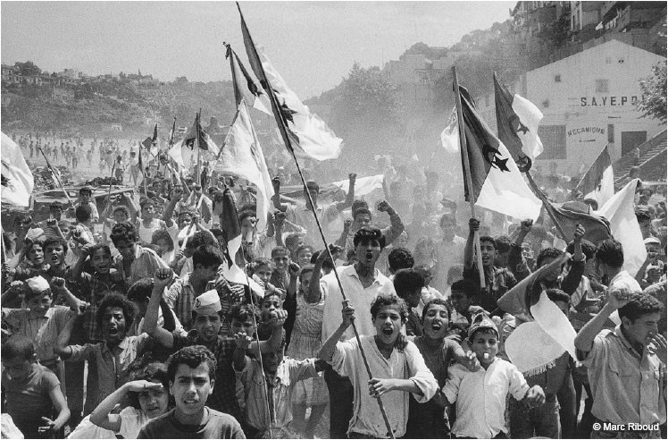
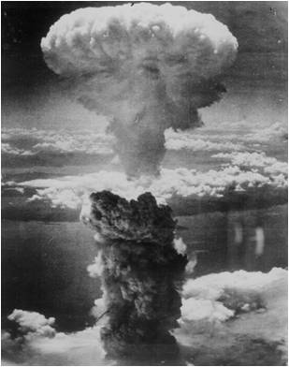
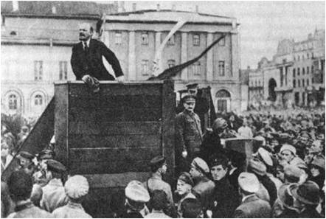
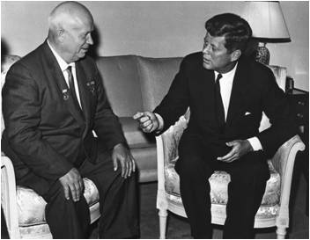
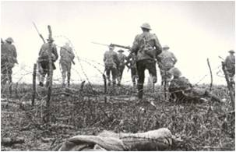
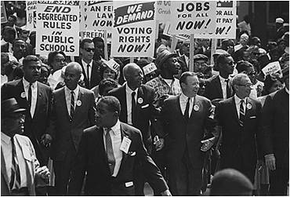
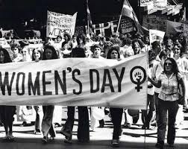
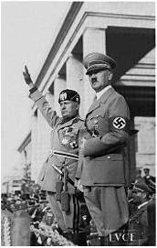
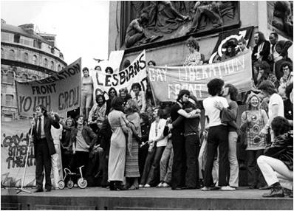
Political events

Slide 5
Key questions
What is meaning and purpose of politics?
What is freedom and how is it achieved?
What is equality and how is it achieved?
Who should rule
and why?
What is power and how does it work?
What is the role of
the state?

Slide 6
Practicalities
Minerva
Lectures
Seminars

Slide 7

Module Assessment: How it Works
TWO ESSAYS, EACH WORTH 50% OF FINAL GRADE
1500 WORDS EACH
YOU WILL BE ASKED TO ANSWER A QUESTION ABOUT TWO THINKERS FOR EACH ESSAY = YOU WILL BE ASSESSED ON FOUR OUT OF THE TEN THINKERS
THE ESSAYS ARE PARTIALLY UNSEEN, SO SOMEWHAT AKIN TO AN EXAM

Slide 8
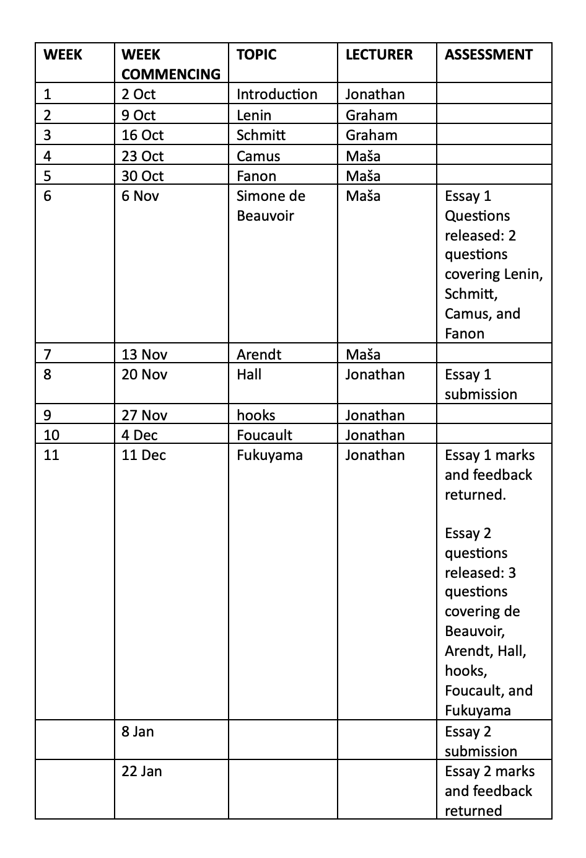
Module Assessment: Timings

Slide 9
Module Assessment: The Rationale
Engaging with a wider range of thinkers/topics
Honing your ability to summarise complex ideas clearly and directly
Avoiding undue pressure on the final assessment
Giving time to act on feedback
Incentivising attendance, engagement and doing the reading

Slide 10
Getting Help
Please consult the module Minerva pages!
Email me as module leader, your seminar tutor, or the person giving the lecture on the topic about which you have a question
Make use of student support hours

